Slide 1

EASY TRACK
SaiMahith Chigurupati 002700539
Maruti Mohit Rayalacheruvu 002109594
Mohitha Edara 002770011 Prakhya Dasari 002774723

Slide 2

PURPOSE
In order to help keep a track of expenses, we designed an expense-tracker application for users to add all of their expenses, divided into multiple categories, and view a detailed summary of how much they are spending.

Slide 3
FEATURES
CRUD expenses
Split expenses into ‘expense’ and ‘income’ type transactions
Group expenses into multiple categories while creating
Filter expenses using frequency and transactions-type
View expense analytics with charts and expense types, to see the total transactions and total turnover

Slide 4





TECHNOLOGY STACK USED
HTML
SASS
JavaScript
MongoDB
React
ANTD
Express
Axios

Slide 5
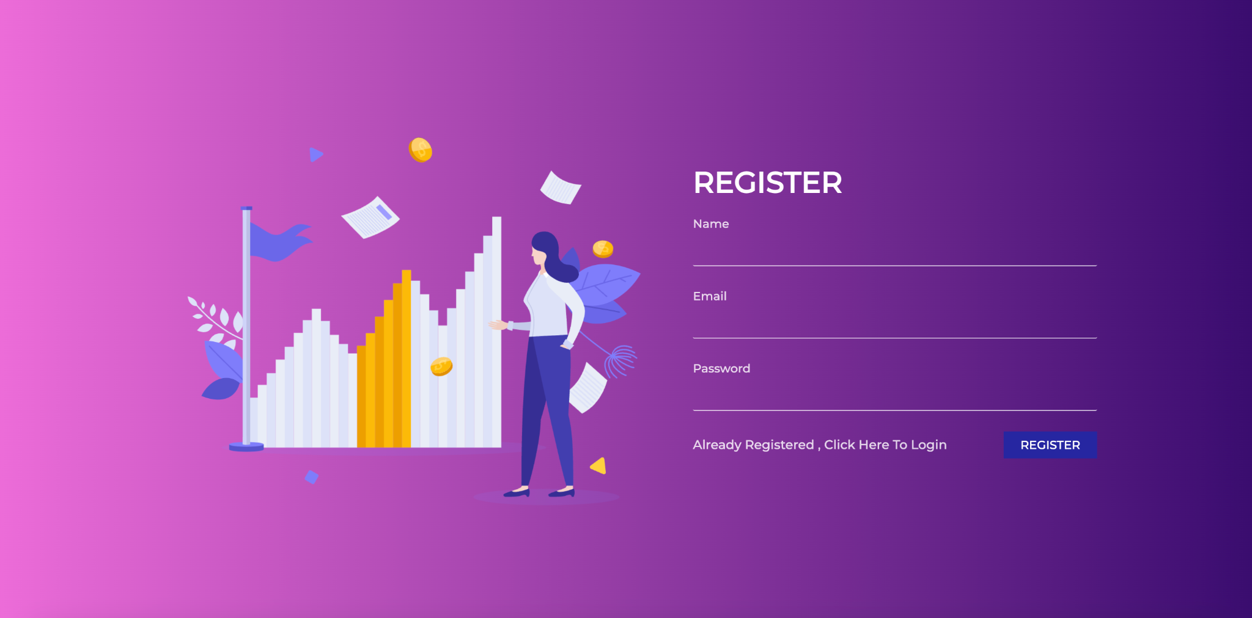
SCREENSHOTS
Register page

Slide 6
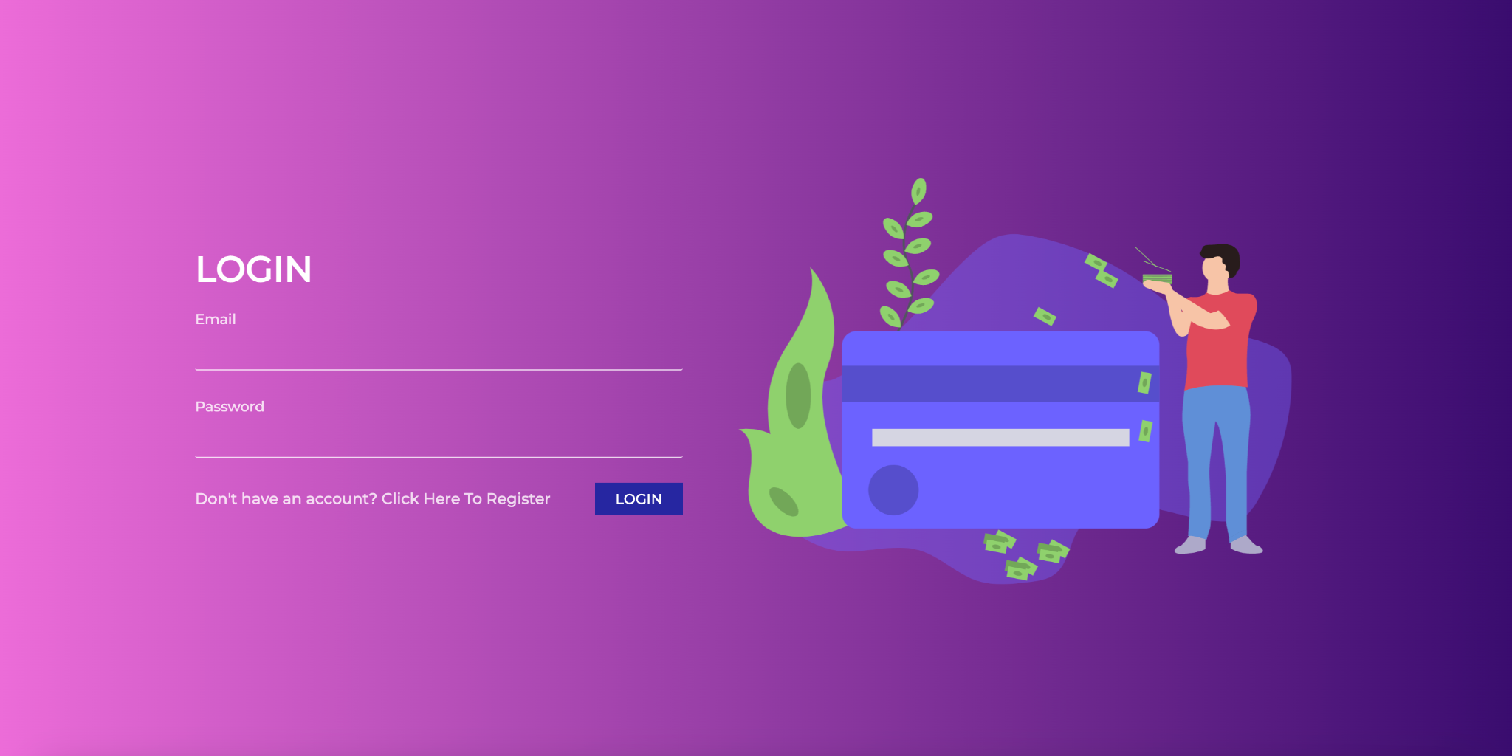
SCREENSHOTS
Login page

Slide 7
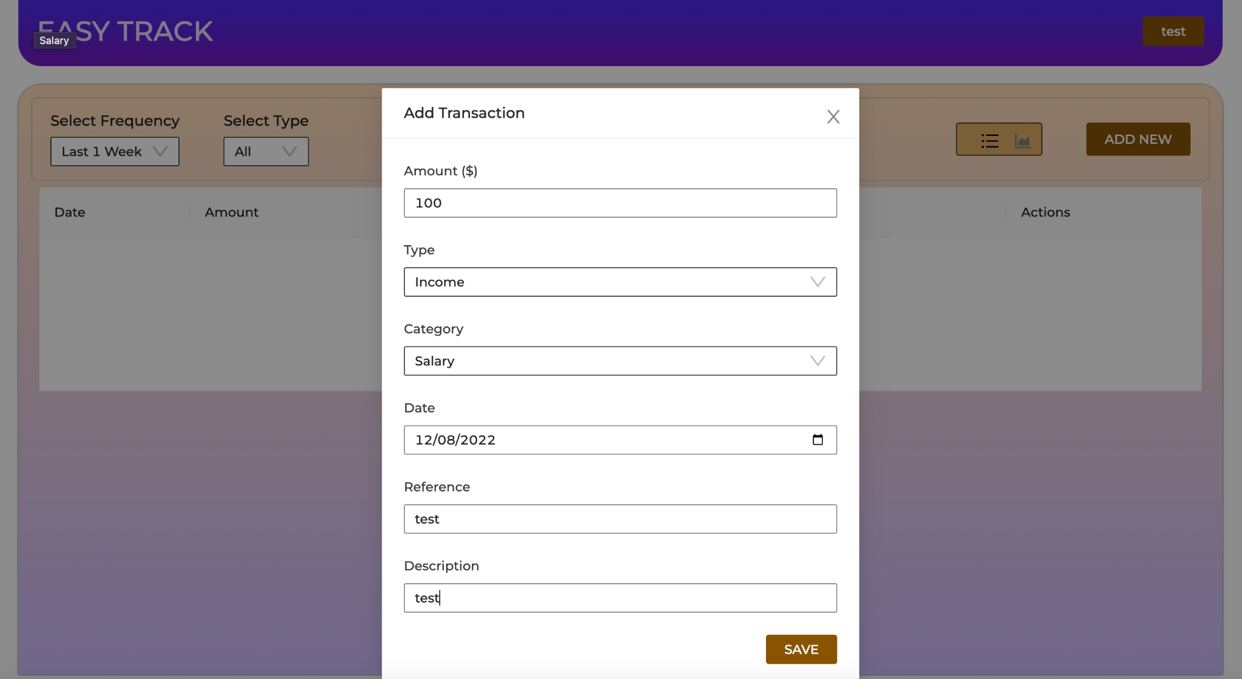
SCREENSHOTS
Adding expense

Slide 8
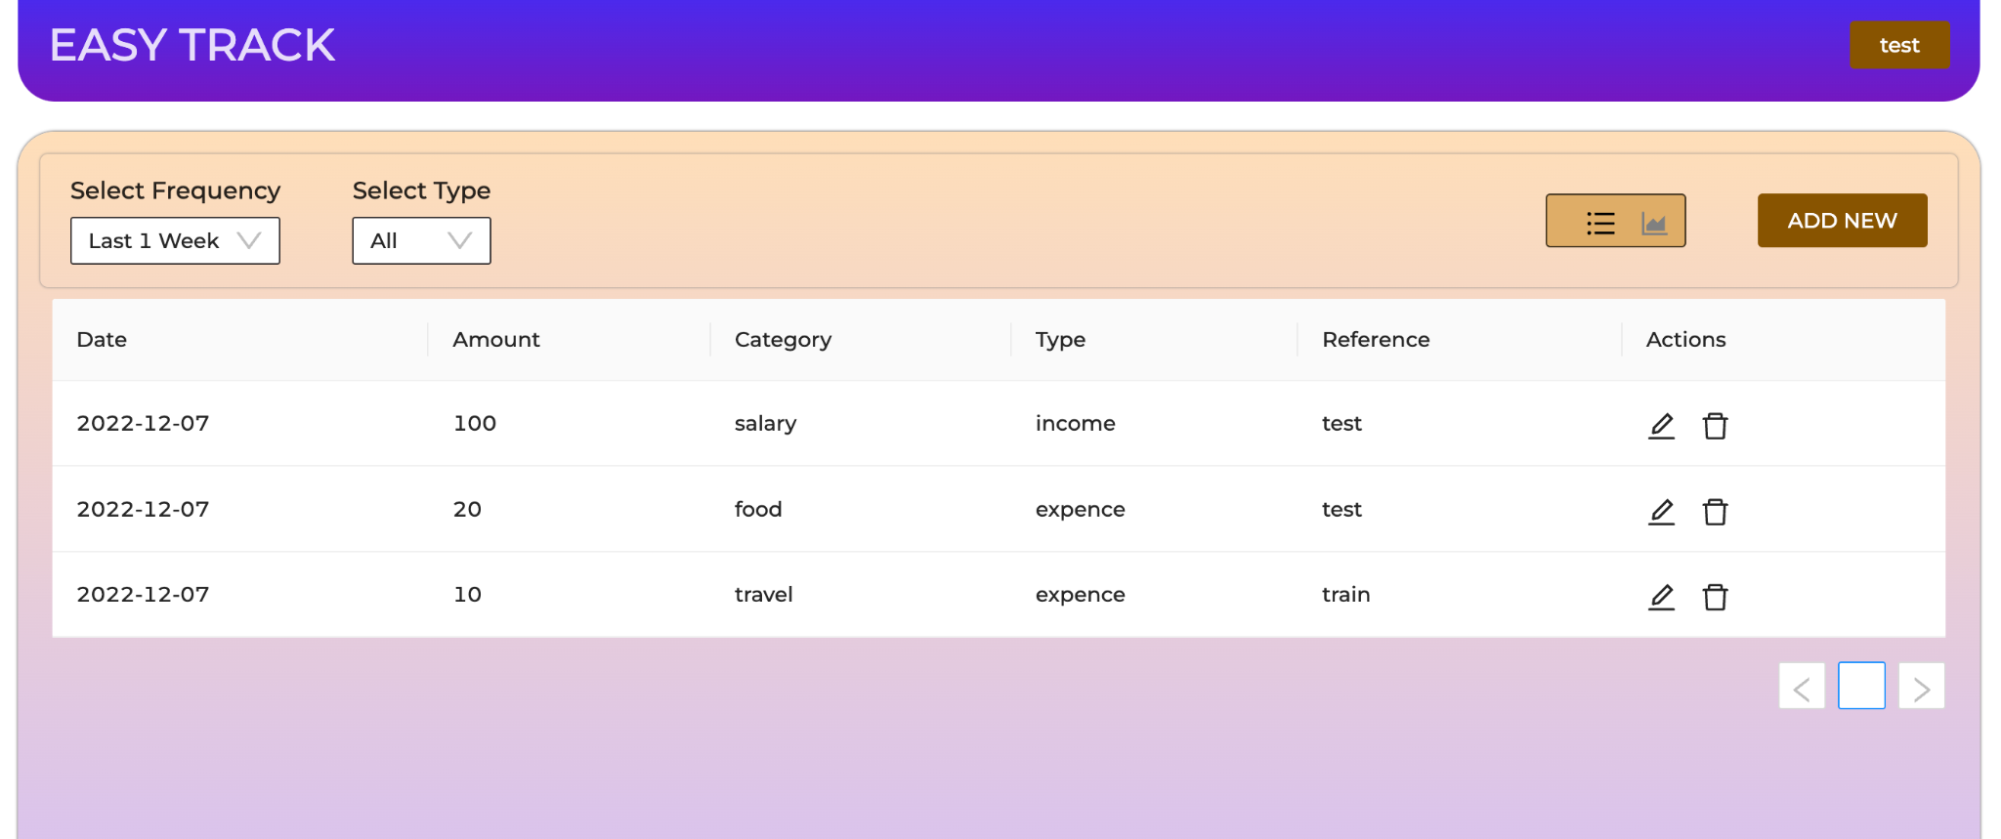
SCREENSHOTS
Dashboard

Slide 9
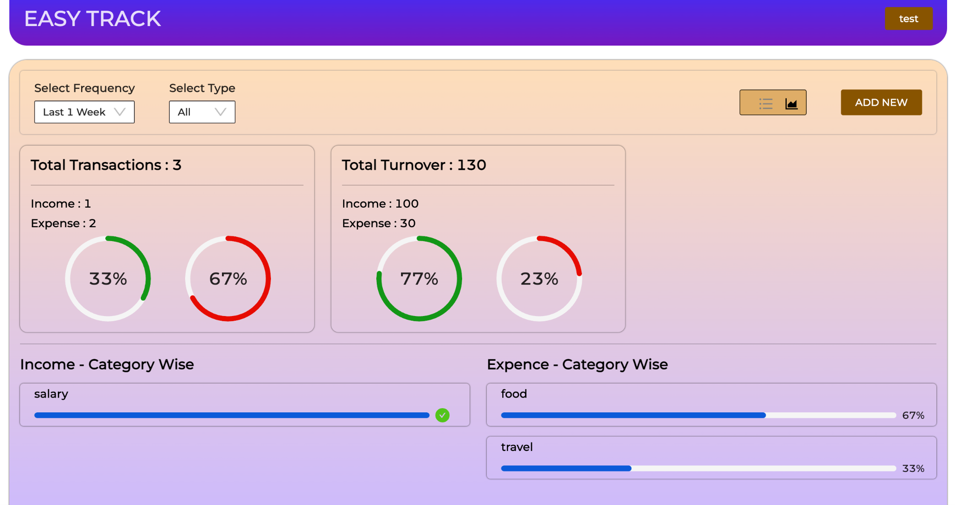
SCREENSHOTS
Analytics

Slide 10
THANK YOU

